Slide 1


Electronic Circuit Fundamentals

Slide 2
Table of Contents
01
Introduction.
02
Fundamentals of Voltage, Current, and Resistance.
03
Key Electrical Laws and Principles.
04
Understanding Battery Configurations.
01
Introduction
•
Interpreting Data Sheets.
Project Calculations and Planning
05
06

Slide 3
01
Introduction
Electricity is a fundamental part of modern technology, used in countless devices and systems. Understanding basic electrical concepts is essential for engineers, technicians, and anyone working with electrical or electronic systems. Below is a foundational overview of key concepts in electricity.

Slide 4
01
Introduction
• What is Electricity?
Electricity is the flow of electric charge, typically through a conductor such as a wire. This flow is driven by a difference in electric potential (voltage). Electricity is the foundation for operating devices, lighting, and powering machines.

Slide 5
02
Voltage, Current, and Resistance
02
Voltage, Current, and Resistance

Slide 6
02
Voltage, Current, and Resistance
1) VOLTAGE.
2) CURRENT.
3) RESISTANCE.

Slide 7
02
Voltage, Current, and Resistance
1) VOLTAGE.
• Voltage is defined as energy per unit of charge.
• The unit of voltage is the volt.
• symbolized by V.
2) CURRENT.
3) RESISTANCE.

Slide 8
02
Voltage, Current, and Resistance
1) VOLTAGE.
2) CURRENT.
• Current The rate at which electric charge flows through a conductor.
• The unit of current is the Amperes.
• symbolized by I.
3) RESISTANCE.

Slide 9
02
Voltage, Current, and Resistance
1) VOLTAGE.
2) CURRENT.
3) RESISTANCE.
● Resistance The opposition to the flow of electric current.
● The unit of Resistance is the Ohm’s (Ω).
● symbolized by R.

Slide 10
02
Voltage, Current, and Resistance
More about RESISTANCE:
Carbon job is the most famous of the electric flame Also known as its representative pair's resistor 220-ohm color (red red brown silver).
• By searching in Google, we find many sites that calculate the resistance value.
• Example of a resistor calculator site:
https://www.resistor-calculator.com/

Slide 11
03
Key Electrical Laws and Principles
03
Key Electrical Laws and Principles
voltage
resistance
current

Slide 12
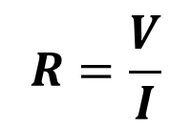
03
Key Electrical Laws and Principles
1) Ohm’s Law
• Ohm’s law states that current is directly proportional to voltage and inversely proportional to resistance.
• Ohm’s law formula
voltage
resistance
$$R=\frac{V}{I}$$
current

Slide 13


03
Key Electrical Laws and Principles
ENERGY AND POWER
• Energy is the ability to do work (Joule)
• Power is the rate at which energy is used (Watt)
• Power law formula
• Energy law formula
$$P=VI$$
$$E=Pt$$
time

Slide 14
04
Understanding Battery Configurations
04
Understanding Battery Configurations

Slide 15
04
Understanding Battery Configurations
batteries can be connected in two ways:..
• Series Configuration Connection: Positive terminal of one battery connects to the negative terminal of the next.
• Effect on Voltage and Capacity: Voltage: Adds up. Capacity (current): Remains the same.​

Slide 16
04
Understanding Battery Configurations
batteries can be connected in two ways:.. • Parallel Configuration Connection: Positive terminals are connected, and negative terminals are connected.
• Effect on Voltage and Capacity:
Voltage: Remains the same.​ Capacity (current): Adds up.

Slide 17
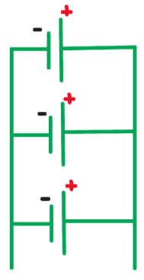

04
Understanding Battery Configurations
Series Configuration Connection
Parallel Configuration Connection

Slide 18
05
Interpreting Data Sheets
06
Project Calculations and Planning

Slide 19
06
Project Calculations and Planning
06
Project Calculations and Planning

Slide 20
06
Project Calculations and Planning
• To solidify our understanding of the concepts covered in the previous slides, let’s work through a practical example. This hands-on approach will clarify and reinforce key points.
• Here’s how we can effectively manage the power requirements for a simple object-avoidance car project.

Slide 21
06
Project Calculations and Planning
• To solidify our understanding of the concepts covered in the previous slides, let’s work through a practical example. This hands-on approach will clarify and reinforce key points.
• Here’s how we can effectively manage the power requirements for a simple object-avoidance car project.

Slide 22
06
Project Calculations and Planning
1. Voltage and Current Requirements:
Component | Voltage Required | Current (A) (Typical) | Quantity | Total Current (A)
DC Motors | 12V | 1A | 4 | 4A
Servo Motor | 5V | 1A | 1 | 1A
L293D Motor Drivers | 12V (motors) / 5V (logic) | 0.1A per driver (logic) | 2 | 0.2A
Ultrasonic Sensor | 5V | 0.015A | 1 | 0.015A
$$\text{•} Total Current = 4A+1A+0.2A+0. 015A = 5.215A$$

Slide 23
06
Project Calculations and Planning
2. Battery Voltage
• Main Battery Voltage:
12V (chosen to match the DC motors and motor drivers' requirements).
• Voltage Regulation:
Use a 5V regulator to step down from 12V for the servo motor, ultrasonic sensor, and L293D logic.

Slide 24
06
Project Calculations and Planning
2. Battery Voltage
• Main Battery Voltage:
12V (chosen to match the DC motors and motor drivers' requirements).
• Voltage Regulation:
Use a 5V regulator to step down from 12V for the servo motor, ultrasonic sensor, and L293D logic.

Slide 25
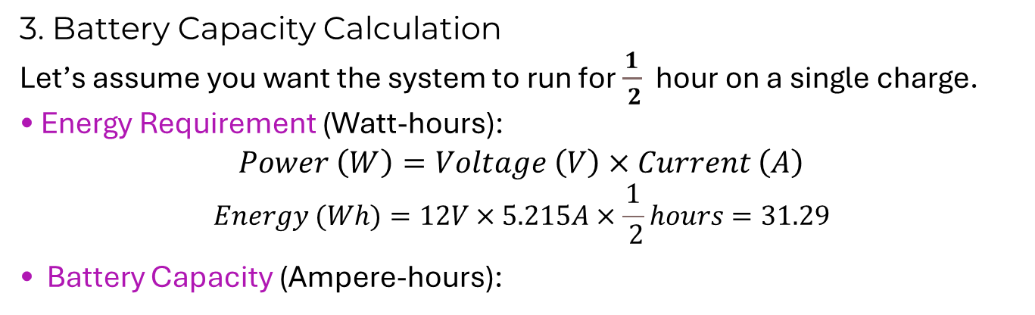
06
Project Calculations and Planning
3. Battery Capacity Calculation
Let’s assume you want the system to run for $\frac{1}{ 2}$ hour on a single charge.
• Energy Requirement (Watt-hours): $$Power \left(W\right)=Voltage \left(V\right)×Current \left(A\right)$$
$$Energy (Wh)=12V×5.215A×\frac{1}{ 2}hours=31.29$$
• Battery Capacity (Ampere-hours):
$Capacity \left(Ah\right)=\frac{Energy \left(Wh\right)}{Battery Voltage \left(V\right)}=\frac{31.29}{12}=2.6075Ah$​

Slide 26
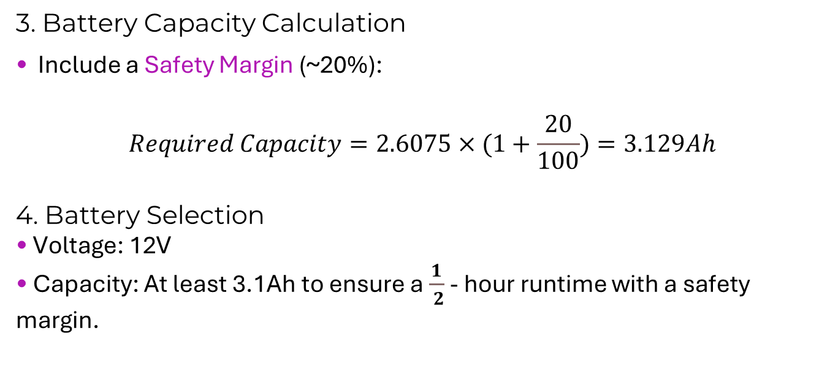
06
Project Calculations and Planning
3. Battery Capacity Calculation
• Include a Safety Margin (~20%):
$$Required Capacity=2.6075×(1+\frac{20}{100})=3.129Ah$$
4. Battery Selection
• Voltage: 12V
• Capacity: At least 3.1Ah to ensure a $\frac{1}{ 2}$ - hour runtime with a safety margin.

Slide 27
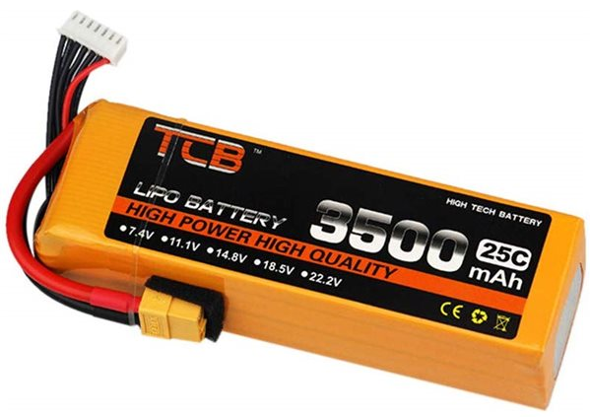

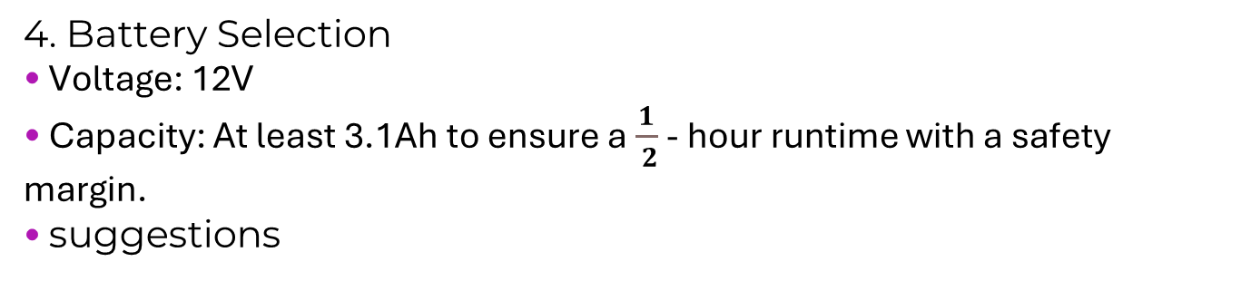
06
Project Calculations and Planning
4. Battery Selection
• Voltage: 12V
• Capacity: At least 3.1Ah to ensure a $\frac{1}{ 2}$ - hour runtime with a safety margin.
• suggestions
$run time= \frac{\text{Battery} \text{Capacity}}{load current}$ = $\frac{3.5}{5.215}$ ≈ 0.7 hours

Slide 28
06
Project Calculations and Planning
5. Final Circuit Overview
12V Battery
+ -
| |
| |------------------------------
| | GND |
| -------
|-> 12V Rail -> L293D (Vcc2, Motors)
|-> 5V Regulator -> 5V Rail
|-> Servo Motor
|-> Ultrasonic Sensor
|-> L293D (Vcc1, Logic)
|-> Microcontroller

Slide 29
Thanks
IEEE RAS BAU - Center
ras.ieee.bau
IEEE BAU Robotics and Automation Society - Center
BAU-RAS workshops manager:
Jullnar Radwan

